Slide 1


Embedded databases introduction
Discover how embedded databases power mobile applications, enabling offline functionality and enhancing user experience through local data storage.

Slide 2
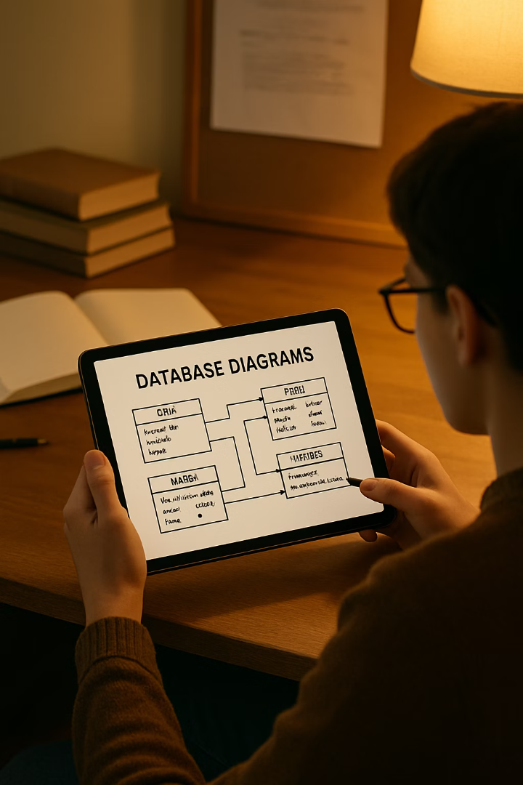
What You'll Learn
1
Embedded Database Fundamentals
2
Key Features
Identify important capabilities of embedded databases.
Understand what embedded databases are and their benefits for mobile apps.
3
Database Comparison
Compare various embedded databases and their specific use cases.

Slide 3
The Mobile App Challenge
The Problem
The Solution
When users lose internet connection, apps can become unresponsive.
Embedded databases deliver fast, reliable, offline-capable apps.
Data might be lost during connection drops.
They provide local storage within the app itself.
This creates frustrating user experiences.
This enhances both performance and user experience.

Slide 4

What Are Embedded Databases?
Local Operation
Minimal Configuration
Work directly within your application, storing data locally on your device.
Unlike server-based databases, they require minimal setup.
Offline Capability
Perfect for offline access, quick retrieval, and efficient data management.

Slide 5





Key Features of Embedded Databases
Local Storage
Better Performance
Lightweight Design
Ease of Use
Data stored directly on device ensures functionality even offline.
Straightforward APIs for simple interaction during development.
Faster access to data since database is integrated within app.
Minimal footprint makes them ideal for mobile environments.

Slide 6








SQLite: The Popular Choice
Cross-Platform
ACID Compliant
Works across different operating systems and devices.
Ensures Atomicity, Consistency, Isolation, and Durability.
Lightweight
Android Integration
Serverless SQL database engine with minimal footprint.
Widely used in Android apps due to SDK integration.

Slide 7





Realm: Modern Alternative
Object-Oriented Approach
Works directly with objects instead of SQL queries.
Simple Data Model
Uses objects for intuitive data handling.
Fast Performance
Built-in threading support enhances speed.
Real-Time Updates
Ideal for chat apps or collaborative tools.

Slide 8






LocalStorage: Web Storage Solution
Browser-Based
Available in modern web browsers
Key-Value Storage
Simple pairs for data organization
Persistent Data
Data remains even when browser closes
LocalStorage is ideal for small amounts of data like user preferences in web applications or hybrid mobile apps using frameworks like Cordova or Ionic.

Slide 9



Couchbase Lite: NoSQL for Mobile
Synchronization Capabilities
Works with Couchbase Server for distributed apps
JSON Document Storage
Flexible data format for modern applications
Full-Text Search
Advanced search within stored documents
Couchbase Lite is used in applications that require syncing data across multiple devices, such as note-taking apps or project management tools.

Slide 10




eXtremeDB: High-Performance Storage
In-Memory Database
High-Speed Transactions
Flexible Storage
Provides high-performance data storage and retrieval.
Supports both in-memory and on-disk storage options.
Optimized for rapid data operations.
eXtremeDB is suitable for gaming or financial applications where speed is critical.

Slide 11
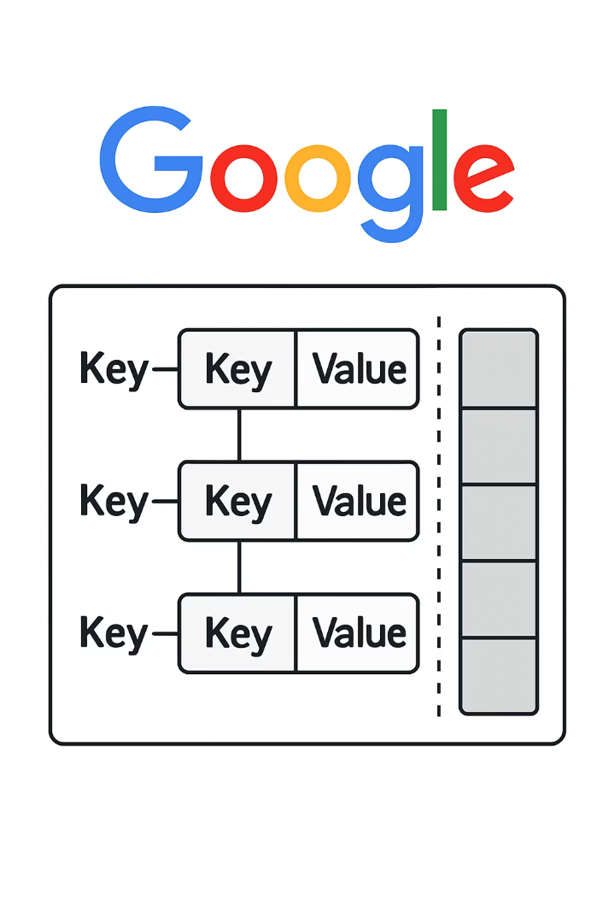
LevelDB: Google's Key-Value Storage
Fast Storage Library
Developed by Google for efficient data handling.
Sorted Order
Provides data in organized, sorted sequence.
Lightweight Integration
Easy to incorporate into existing applications.
High Performance
Optimized for quick read and write operations.
LevelDB is used where quick lookup and storage of key-value pairs are needed, such as caching or session storage.

Slide 12







BerkeleyDB: Flexible and Reliable
Multiple Data Models
High Performance
1
Supports key-value and relational models
Optimized for speed and reliability
Multithreaded Support
ACID Compliance
Handles concurrent operations efficiently
Ensures data integrity and reliability
BerkeleyDB is suitable for applications that require complex transactions and large-scale data management, like financial applications.

Slide 13

Database Comparison
Database
Type
Performance
Best For
SQLite
SQL
Good
General purpose
Realm
Object
Very Good
Real-time apps
CouchBase Lite
NoSQL
Good
Sync-heavy apps
eXtremeDB
In-memory
Excellent
Speed-critical apps

Slide 14

Best Practices: Database Selection
Assess Application Needs
Consider data complexity, offline requirements, and sync needs.
Evaluate Performance Requirements
Determine speed needs and expected data volume.
Consider Platform Compatibility
Ensure database works with your target platforms.
Select Most Suitable Database
Choose based on your specific requirements.

Slide 15
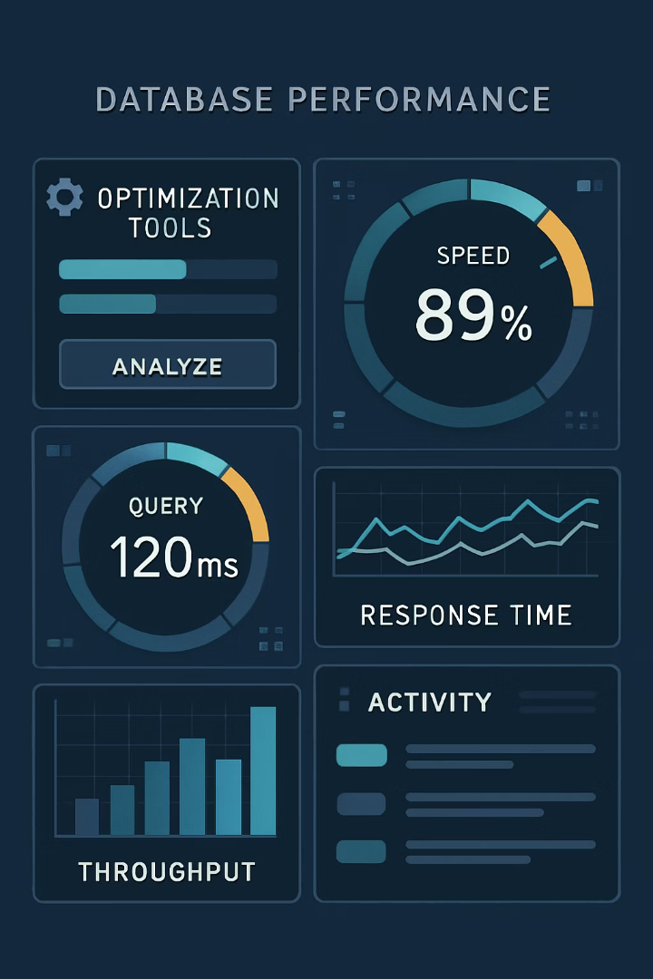



Best Practices: Performance Optimization
Implement Indexing
Create proper indexes for frequently queried fields.
Optimize Queries
Write efficient queries to minimize processing time.
Manage Data Volume
Store only necessary data to reduce memory usage.

Slide 16
Best Practices: Data Security & Testing
Data Security
Thorough Testing
Implement encryption for sensitive data
Test in offline environments
Use secure access methods
Verify data integrity after sync
Follow platform security guidelines
Stress test with large data volumes
Regularly update security measures
Test on actual target devices

Slide 17
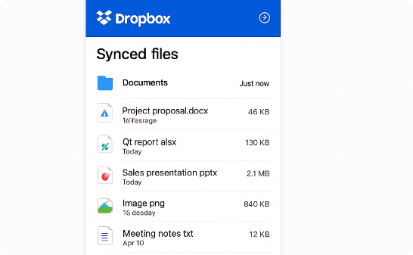

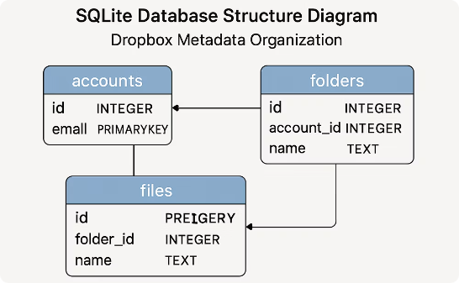
Real-World Example: Dropbox with SQLite
File Management
Offline Access
Database Structure
SQLite manages file metadata and sync status efficiently.
Users can access files without internet connection.
Optimized for quick file status updates and syncing.

Slide 18
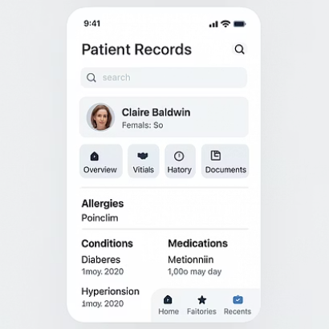
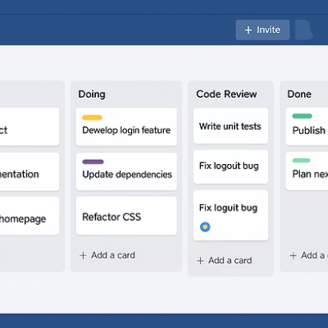

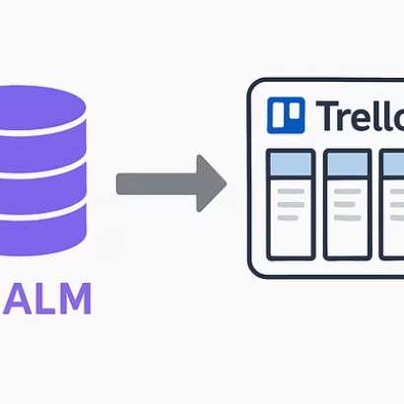
Real-World Examples: Healthcare & Productivity
CouchBase Lite enables healthcare apps to access patient records offline. Realm powers Trello to manage task boards and sync user data in real time.

Slide 19

Real-World Examples: Gaming & Browsing
1000+
2B+
5x
Games Using BerkeleyDB
Chrome Users
Faster Browsing
Stores player profiles, game stats, and high scores.
LevelDB powers Chrome's local data storage.
Efficient data retrieval improves browser performance.

Slide 20

Key Takeaways
Embedded Database Fundamentals
1
Work within applications, offering local storage and offline access.
Distinct from Traditional Databases
Don't rely on server connections, offering offline functionality.
Multiple Options Available
SQLite, Realm, LocalStorage, CouchBase Lite, eXtremeDB, LevelDB, and BerkeleyDB.
Best Practices Matter
Choose wisely, optimize performance, manage sync, secure data, and test thoroughly.

